Slide 1
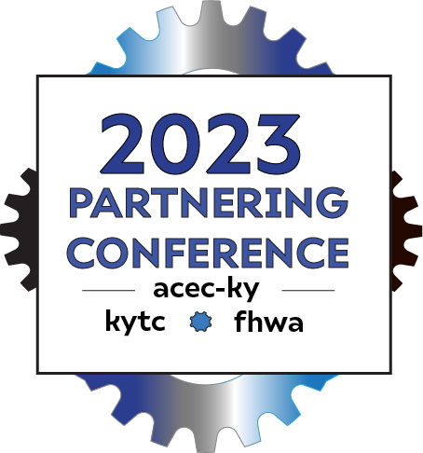
Successful Alternative Delivery
Erika Drury, Alternative Delivery Program Manager
September 5th, 2023

Slide 2
Alternative Delivery Program
Alternative Delivery Program Manager
Erika Drury
Delivery Team 1
WSP Team
Independent Cost Estimator
ICE Teams
Independent Cost Estimator
Stanton Constructability Services
Delivery Team 2
Structurepoint/Garver
Design SME
Amanda Desmond Construction SME
Mark Walls

Slide 3
Active Alternative Delivery Projects
Project | Delivery Method
KY 8 Licking River Bridge Kenton County | Progressive Design Build
US 421 Harlan County | Progressive Design Build
Mountain Parkway Expansion Magoffin-Floyd Counties | Progressive Design Build
I-65 Jefferson County | CM/GC

Slide 4
Alternative Delivery Projects in Procurement
Project | Delivery Method | Next Milestone / Date
Wrong Way Driving Prevention Project | PDB | Proposals Due-October 4th

Slide 5
Progressive Contracting
KYTC is actively developing projects that will be delivered using progressive contracting methods such as Progressive Design Build (PDB) and Construction Manager General Contractor (CM/GC)
The key feature of these contracting methods is that construction price is not established until after selection of the PDB contractor or CM/GC. This allows for multiple benefits including better risk mitigation and greater price certainty.
Additional information related to these delivery methods is available at:
CM/GC - https://www.fhwa.dot.gov/construction/contracts/acm/cmgc.cfm
PDB- https://dbia.org/wp-content/uploads/2018/05/Primer-Progressive-Design-Build.pdf

Slide 6
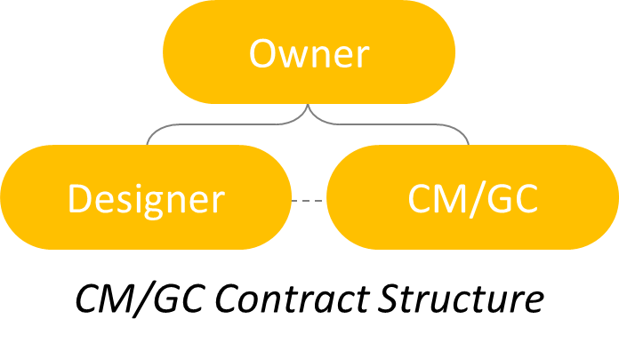
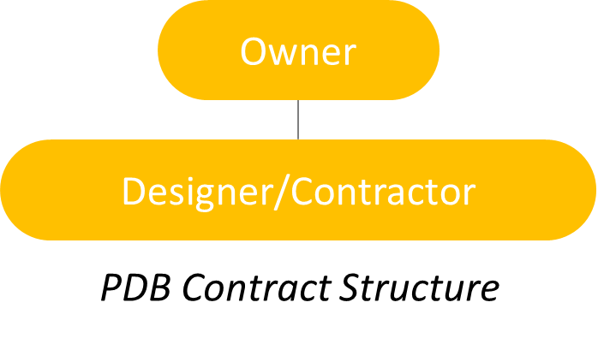
PDB v. CM/GC
The primary difference between PDB and CM/GC is the contractual framework

Slide 7
BENEFITS
BILLION
Less investment in proposal process
Compensated for pre-construction work activities
Greater collaboration
More opportunity for innovation
Better risk management

Slide 8
Contractor Role During Preconstruction Phase
Be part of design development process
Provide real time constructability reviews
Optimize the construction schedule
Obtain input on staging of the work
Assist with risk identification and mitigation
Develop its own estimates at Pricing Milestones established in the contract.

Slide 9
Independent Cost Estimator (ICE) Role
Participate during milestone pricing
Develop bottom-up estimates and estimate reconciliation, using open book estimating
Allows open, transparent comparison that can be compared to the independent cost estimate
Attend regular estimate task force meetings

Slide 10
Risk Management
Risk Management Process is more focused
Provide transparency in pricing the risk
Optimize the construction schedule

Slide 11
Is My Project a Good Alternative Delivery Candidate?

Slide 12
Factors to Consider
Complexity
Scope variability
Need for early Contractor input
Risk profile
Competition
Speed of Procurement

Slide 13
Planning for Success in Delivery
Strong Project Manager
Paradigm Shift
Collaboration is Key
Transparency

Slide 14
Thank you!

